Slide 1
About Soldering with a focus on antenna related stuff
VE3CZO

Slide 2

Soldering…what these sessions are about
This course consists of three sessions
Session one will cover
  Suggestions on how much you should spend on tools
  Tools of the trade and consumables you’re going to need
Then a break so that you have a chance to purchase equipment
Session two – solder together and water proof larger gage wires commonly used for antennas
  18 and 14 gage wire
  Detail various types of joints
  Weatherproof joints
  Jigs and vices to ease construction
  Strip insulation and tin a wire end
  Build two solder wire joints using 18 & 14 ga. stranded wire and weather proof them
Session three – Coax & Connectors
  Choosing connectors and coax – what to look for and what to avoid
  How to work with the coax braid and center conductor when soldering connectors
  How to connect solder lugs to coax
  Create a jumper cable by soldering two PL259m connectors onto RG8X coax
  Demo waterproofing 2 PL259’s with a barrel connector
Notes:
In the first session we’ll talk about the four basic soldering tasks we’ll be addressing, a lot about the tools needed to solder successfully, and how much you should spend on them, the types of components you’ll be soldering.
There will be a bit of a break between the first and subsequent sessions to provide every one an opportunity to acquire tools.
In the subsequent two sessions I’ll provide some demos and how-to’s that will lead you to achieving solid antenna wire connections and a bit about coax and connectors.
So let’s get started…

Slide 3
Tools of the Trade
Essential Tools and supplies for Soldering
  Soldering Irons & stations including tips and tip cleaners
  Solder
  Hand tools & vises
  A tiny bit about flux removal
Notes:
We’ll go into quite a bit of detail about soldering irons and stations, the kind of solder to use, the use of a vise to hold and position your work, ESD protection.

Slide 4
How Much Should be Spent on soldering equipment?
That depends…
  Soldering equipment can be quite expensive!
  If you are new to the soldering experience or don’t know how much soldering you’ll do, start minimalist
    Cheap tools can be very effective but can also result in varying degrees of user satisfaction
    Keep monitoring your level of satisfaction in your soldering results and change tools as you learn.
In this session
  I’ll present tools that will work, noting the pro’s and con’s and occasionally telling you what to avoid.
  Don’t feel compelled to buy tools especially if you don’t anticipate using them a lot…borrow them…they will be available during these sessions from me and other participants.
Notes:
We’ll go into quite a bit of detail about soldering irons and stations, the kind of solder to use for both leaded and surface mount assembly, the use of a vise, ESD protection and some tools specifically for SMD work, tweezers and some form of magnification.
And of course because we will make mistakes, almost as important as soldering is de-soldering and clean-up so we’ll also discuss tools for that.

Slide 5

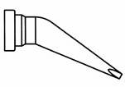
Soldering Irons & Stations
What to look for…
  The Essentials…
    Enough heating power to tackle larger jobs – 40 to 200 watts
    Controlled tip temperature
  Nice to have… if you’re buying an iron that will be used additionally for PCB and/or SMD work…
    Short tip to grip distance – no more that 5 to 6 cm (2-2 ½”)
    ESD safe tip, preferably one that is grounded
    Stable fairly heavy stand with tip cleaning capability
    Replaceable tips
      Two really desirable tips
        Chisel tip about 2.5-3.5 mm end width
        Bent round tip with a point under 3 mm for fine PCB & SMD work
    Sleep state – preferably with a programmable timer
    Tip temperature reading in either Celsius or Fareheight
    Front panel power switch so you don’t have to reach behind the unit to turn it on or off.
Notes:
After controlled tip temperature the most important soldering iron attribute is the tip to grip distance. Most soldering is done with small stuff so you need as much precision as possible. A soldering iron with a long tip to grip distance will make your life miserable. The shorter the tip to grip distance the more precision you will have over your work. Think of a long tip to grip distance like trying to sign your name by holding a pencil or pen at the very opposite end from the tip. It’s much more difficult than gripping the pen near the tip, same with soldering irons.
The tip should be grounded so that stray power isn’t fed to the part being soldered. This can be extremely important with devices like MOSFETS. Be careful with USB soldering irons powered from wall warts rather than power banks as the transformer less power supplies may not provide sufficient isolation from the mains.
Soldering iron power can sometimes be an issue. Inexpensive 8 watt USB soldering irons are ok for most small component but won’t hack it for things like soldering to a good ground plane or heavy gauge wire.

Slide 6
Soldering Irons & Stations
A bit about Heat Transfer…
The Soldering Iron Objective…
  Provide enough heat to the work so that solder flows smoothly enough to complete a solder joint in 2 to 5 seconds. This will be longer for coax shields but should be less that 20 seconds.
Heat Transfer
  Soldering requires that the area to be soldered is far enough above the solder’s melting point so that solder flows freely when applied.
  The amount of heat delivered from the soldering iron to the work depends on…
    The maximum amount of heat the soldering iron or work station can deliver
    The temperature of the soldering iron tip
    The tips contact area with the work & the length of time the soldering iron tip has contact with the work
    The thermal mass of the work
    Cleanliness of surfaces – dirty or oxidized surfaces will require longer times or higher temperatures
  Too little heat will result in long heat times and potentially create cold solder joints
  Too much heat can result in excessive tip wear, and rapid oxidation

Slide 7
Soldering Irons & Stations
A bit about Adjusting Tip Temperature…
  Start with a low temperature and increase if the solder isn’t melting
  The solder should flow freely and form a smooth shiny surface
Soldering irons with fully adjustable temperature settings
  Again the objective should be to complete a solder joint in 2 to 5 seconds.
  Start with a temperature of 300 C (350 C for lead free) and increase in increments of 25 C to meet objectives.
  Avoid going much over 400 C as extended contact at these temperatures could damage PCB copper tracks and the iron tip will oxidize quickly.
Notes:
Good soldering technique comes through practice. So practice, practice, practice

Slide 8
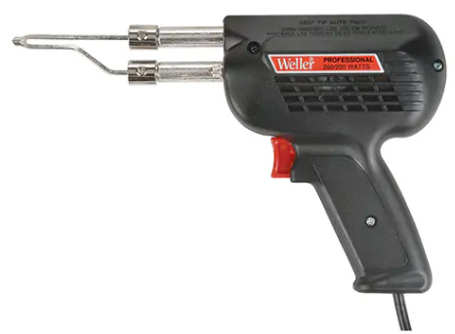
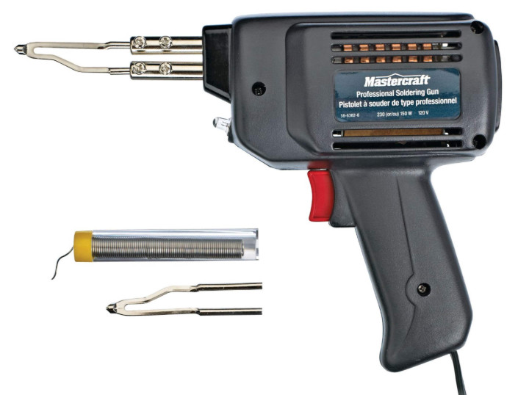
Soldering Irons & Stations
Soldering guns… for really big jobs like soldering the outer braid on coax
Pro’s
  Tips are inexpensive and replaceable
Cons
  Tips are not temperature controlled
    Risks applying too much heat!
  Tips are not grounded
Weller D-550 240-325W soldering gun $130
CTC Mastercraft 230W $95
Notes:
Sometimes you just need a little more heat and don’t really care about the tip temperature or whether the tip is grounded you just want the solder to melt! Instances like soldering ground braid to a fairly large ground plane.

Slide 9
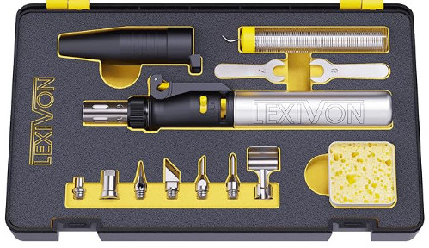
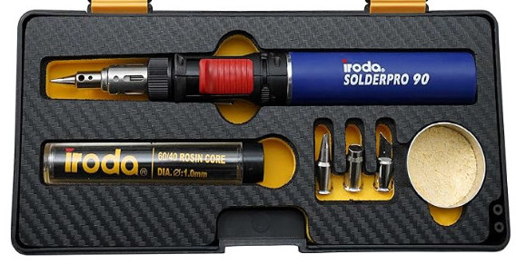
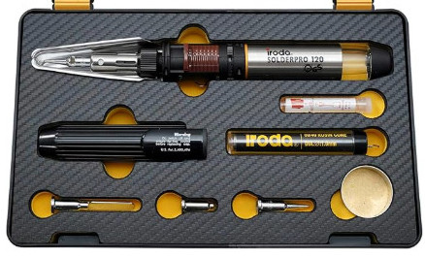
Soldering Irons & Stations
Butane irons… again for really big jobs
Pro’s
  Can also be used for heat shrink
Cons
  Tips are not temperature controlled
    Risks applying too much heat!
  Tips are not grounded
Iroda SolderPro 90
$87
Lexivon $60
Iroda SolderPro 120 $130
Notes:
Sometimes you just need a little more heat and don’t really care about the tip temperature or whether the tip is grounded you just want the solder to melt! Instances like soldering ground braid to a fairly large ground plane. The soldering tip selection isn’t great.

Slide 10
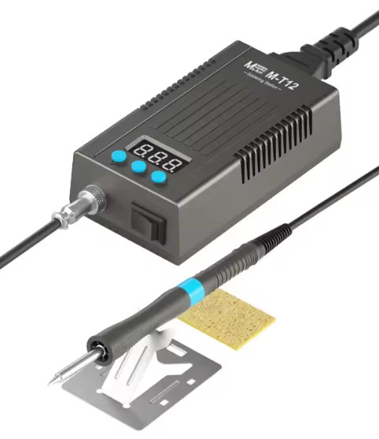
Soldering Irons & Stations
Low cost mains powered soldering irons using T12 tips
Pro’s
  Better tip temperature indication and control
  T12 Tips are interchangeable and often grounded
Cons
  Limited choice in this category
MaAnt M-T12 75W T12 tips $46

Slide 11
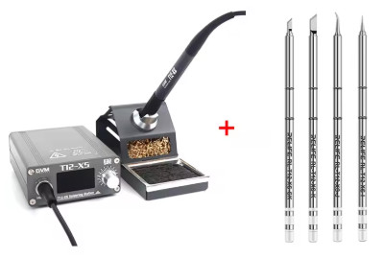
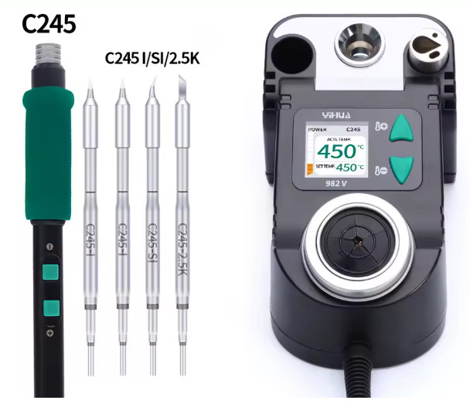
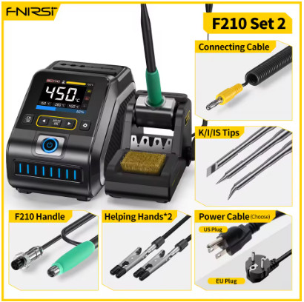
Soldering Stations
Low Cost Stations
Pro’s
  Reasonable tip temperature set, indication, and control
  Tips are inexpensive, interchangeable, and grounded
  Iron holders, and tip cleaning facilities provided
  Timed power down sleep state options
Cons
  Costly but less so than pro stations
RELIFE GVM T12-XS AliExpress $77
YIHUA 982V AliExpress $65
Fnirsi DWS-200 AliExpress $127 with F245 handle add $20 for 210 handle.

Slide 12
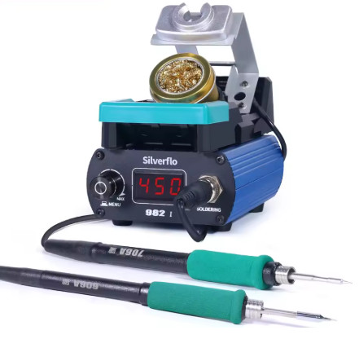
Soldering Stations
Low Cost Stations
Pro’s
  Reasonable tip temperature set, indication, and control
  Tips are inexpensive, interchangeable, and grounded
  Iron holders, and tip cleaning facilities provided
  Timed power down sleep state options
Cons
  Costly but less so than pro stations
Silverflo
AliExpress $85
With C210 & C245 handles

Slide 13
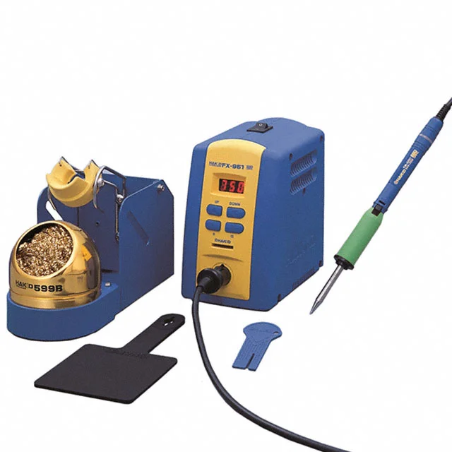
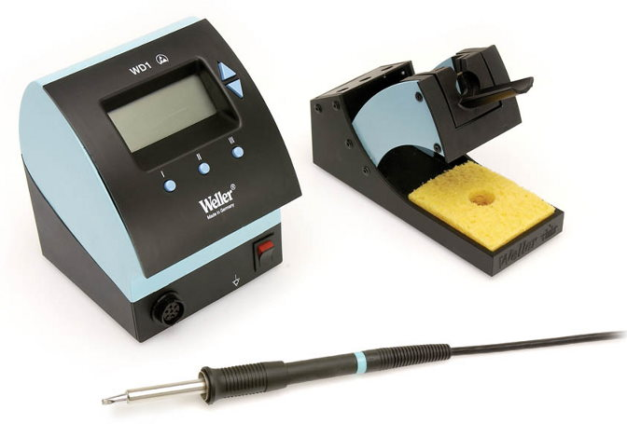
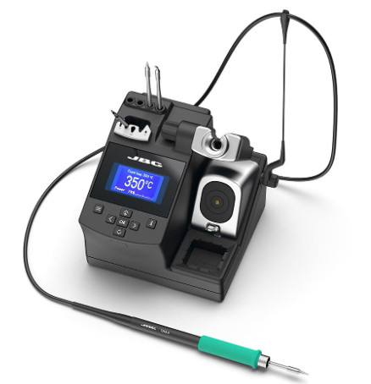
Soldering Stations
Hakko FX-951 Newer FX-971 $330
Pro soldering stations
Pro’s
  Very good tip temperature set, indication, and control
  Tips are inexpensive, interchangeable, and grounded
  Iron holders, and tip cleaning facilities provided
  Timed power down sleep state
  Wide variety of choices but avoid knock-offs
Cons
  Costly
Weller WD1 ($265) with WP80 pencil ($220)
JBC CD-2BHQF $615

Slide 14
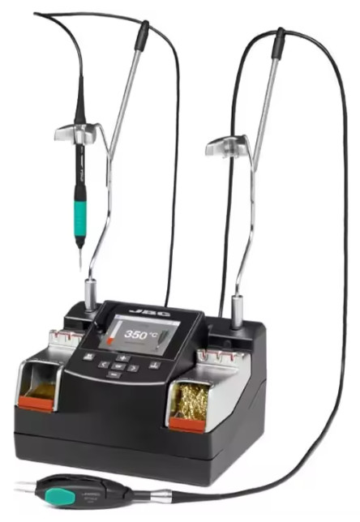
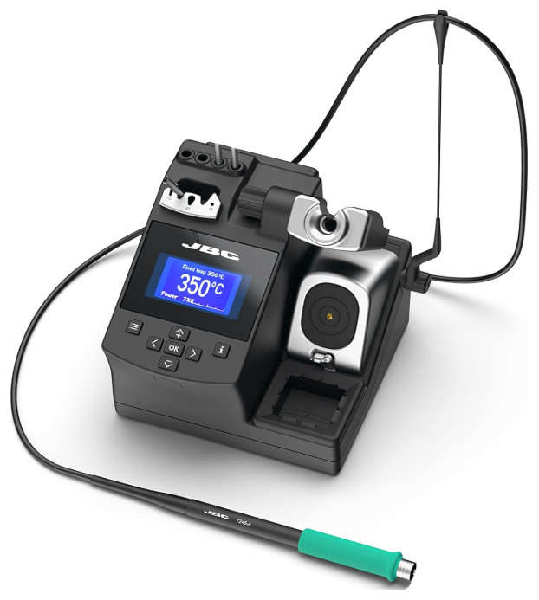
Soldering Stations
Pro soldering stations
Cons
  Very Costly
JBC Nano Rework Station AliExpress $3448
Low end JBC CD-1BQF Amazon $1719

Slide 15
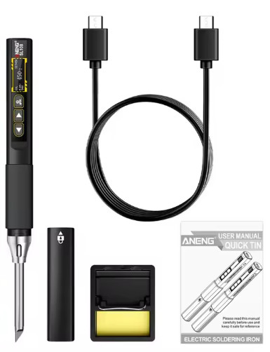
Soldering Irons & Stations
Higher output power USB powered soldering iron
Pro’s
  Better tip temperature indication and control
  Interchangeable tips offer better temp control
  Most have automatic shutdown times
Cons
  Again watch for stray tip voltages when connected to mains powered bricks
  Limited choice of tips
  Require a USB power delivery (PD) compliant power supply that will provide sufficient power typically these irons run 65 to 100W. This will add $25-$30 to the cost
Aneng SL-108 90W T12 tips $25
Notes:
There are a large number of irons with output powers that rival mains powered devices.
The trickiest part is acquiring a power brick or power bank that will deliver 65-100 watts to a single USB C connection. Many bricks with multiple outputs advertise high power delivery but usually combine power from all outputs, and often can’t provide the power required from a single USB C connection. Most irons will also work with lower USB power delivery compliant sources providing 9 12 or 20 V at reduced maximum power.

Slide 16



Replaceable Solder Tips
Many soldering irons and stations offer a variety of tips that are easily interchangeable in most cases by simply pulling the tip out of the iron and pushing a new one in
Hakko T12 and JBC C470, C245, C210, & C115 tips are very common and are multi sourced making them inexpensive
  A variety pack of tips can be purchased for about $30
  Individual tips can be purchased for about $6-8 each from Amazon or AliExpress
  Tips that work well C245 120W, C210 40W, T12 72W
    Hakko T12-D32 chisel for moderately fine work,T12-D52 broad chisel for larger work
    JBC C245-907 chisel for moderately fine work C245-D22 fine chisel
    JBC C210-D chisel although these tips will have limited heat (about 40W) and may be a bit small for larger work
  Large JBC C470 tips are intended for jobs were maximum heat transfer is required but will also need a station capable of delivering over 200 watts.
  Smaller JBC C115 tips are intended for micro soldering
T12 C245 C210
D32 907 D
Chisel soldering tips

Slide 17
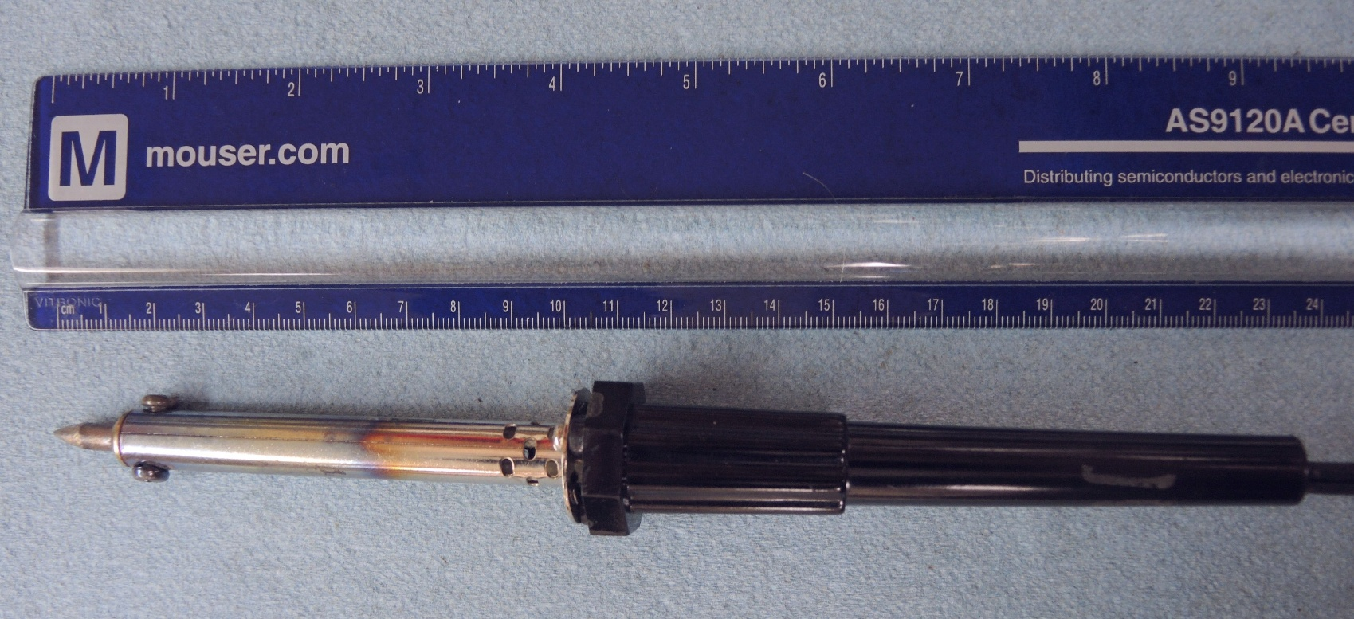
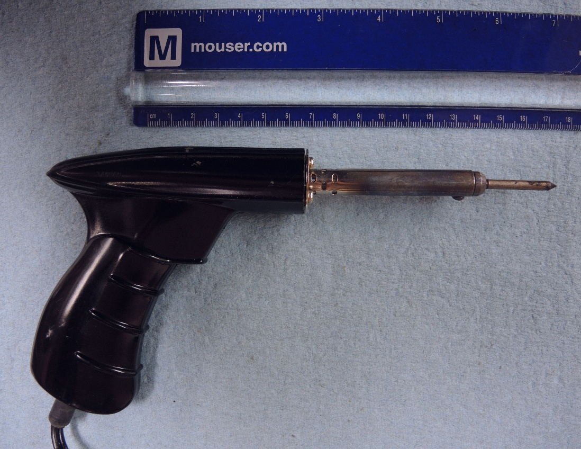
Soldering Irons & Stations
What to avoid…
  soldering irons with long tip to grip distances
  Irons with tips that aren’t temperature controlled
Notes:
But before we go further, just a reminder if what not to use. With soldering irons like those pictured, the tip to grip distance is 12 to 17 cm (5-7”) far too long for precise control. Also the tips are not temperature controlled, nor will they be grounded while the heating element is not typically electrically connected to the tip, stray induction currents could result in unwanted voltages at the tip.

Slide 18
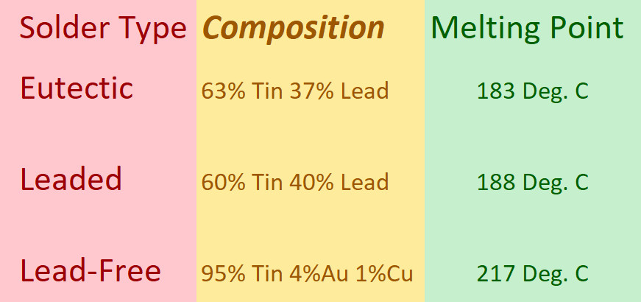
Solder
Composition
  Either tin lead or lead free
    Personal preference – eutectic 63% tin 37% lead – it has a lower melting point, flows better, and leaves a shinier surface so that you can better discern cold solder joints
    All solders should have a flux core; a no-clean flux core is ideal
    Lead free solder is more environmentally friendly but is tougher to work with
      has a higher melting temperature so requires more power from the soldering iron
      produces a rougher finished surface that sometimes makes it hard to identify cold solder joints

Slide 19
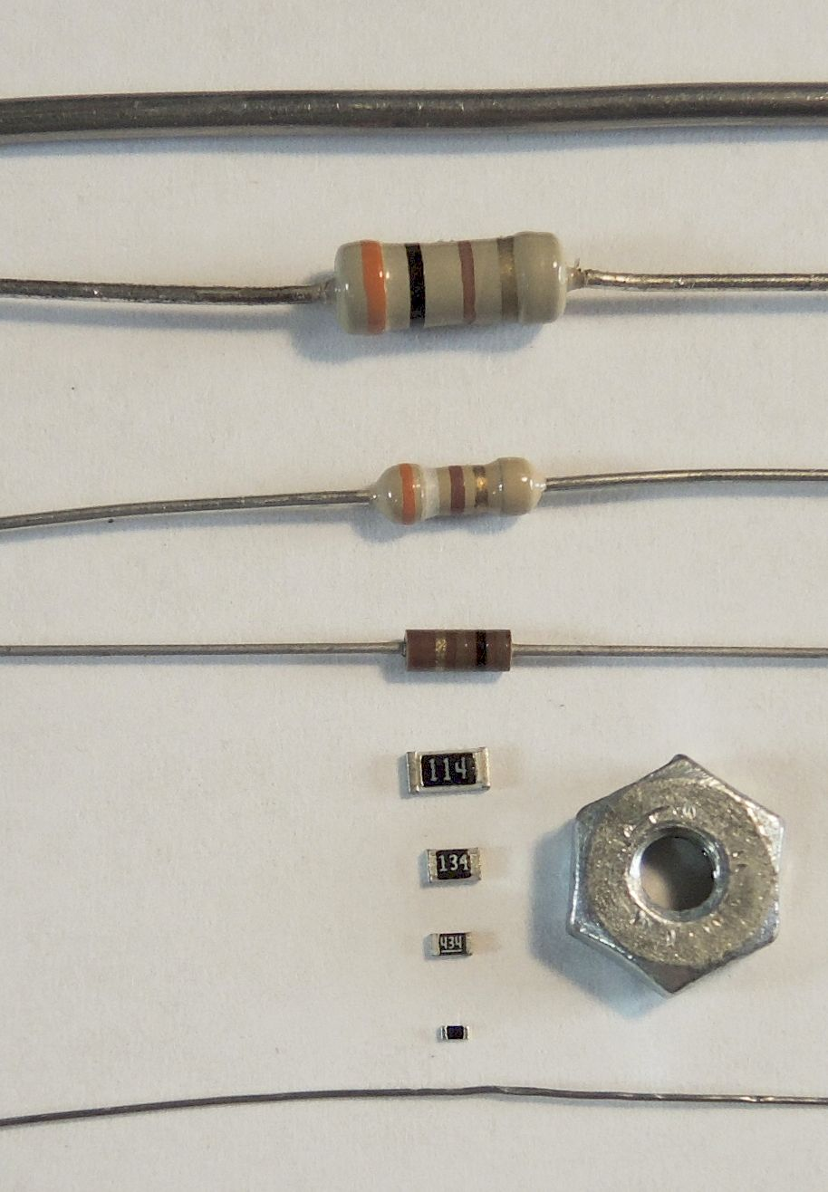
Solder
Solder Size
  Size matters! Attempting to solder small parts with large diameter solder will result in excess solder at the site, potential bridging between leads or PCB lands, and a generally miserable experience .
  Attempting to solder large parts with small diameter solder will result in the inability to feed enough solder to the site in a timely fashion.
  For antenna wire and connectors use 1 – 1.5mm diameters
  For PCB assembly with leaded devices use diameters of 0.5 to 0.8mm
  For SMD devices a diameter of .2 mm to 0.3 mm is best
  Larger diameter solders can be useful for large jobs like flooding ground planes, soldering large diameter or coax cables. The only difference using larger diameter solder in these cases is that a smaller length of solder will be used. So smaller diameter solder can also be used, you will just use a longer piece.
1.6mm Solder
1/2 Watt
1/4 Watt
1/8 Watt
3216 (1206)
2012 (0805)
1608 (0603)
1005 (0402)
0.25mm Solder

Slide 20
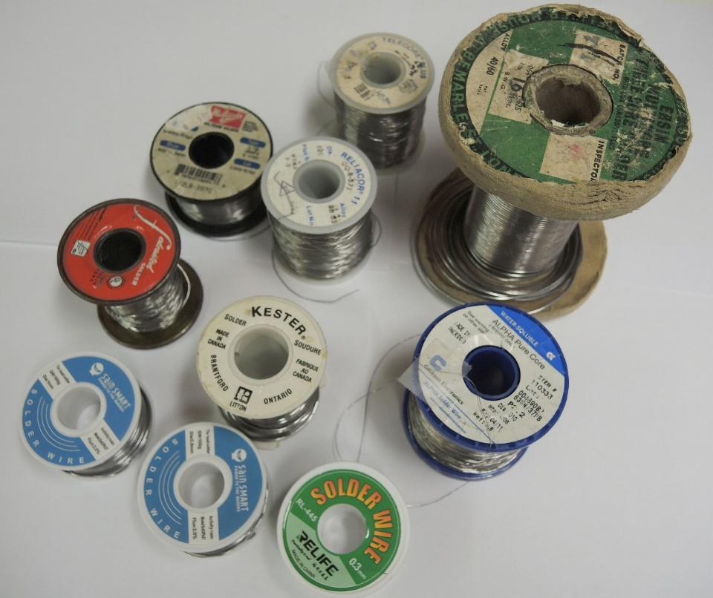
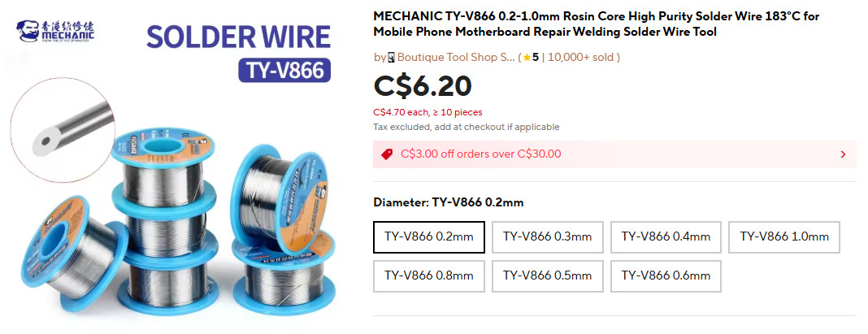
Solder
For the next sessions…
  Solder will be supplied and I’ll bring some different sizes
  You might also want to buy a supply. It’s available from a variety of vendors. 1 & 1.5mm diameter should work well for our purposes

Slide 21
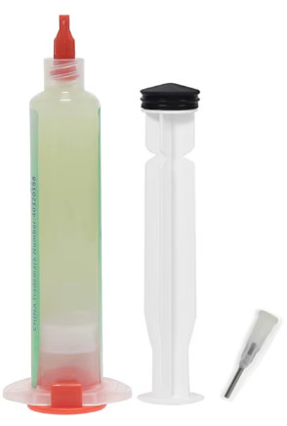
Solder Flux
Why use Flux
  Cleans metal services removing oxides that inhibit bonding
  Improves solder flow promoting wetting. Flux helps solder spread and adhere to metal surfaces. Without flux solder may bead up or form irregular shapes
  Prevents re-oxidation. Metal surfaces can quickly oxidize even during the soldering process. Flux creates a barrier that minimizes re-oxidation ensuring a cleaner more reliable joint
  Rework – when re-heating solder joints it helps the solder melt and flow smoothly
Types of flux available
  Solder with flux cores
  Liquid flux applied with a brush, pen, or through a squeeze bottle dispenser
  Paste flux typically applied with a syringe

Slide 22
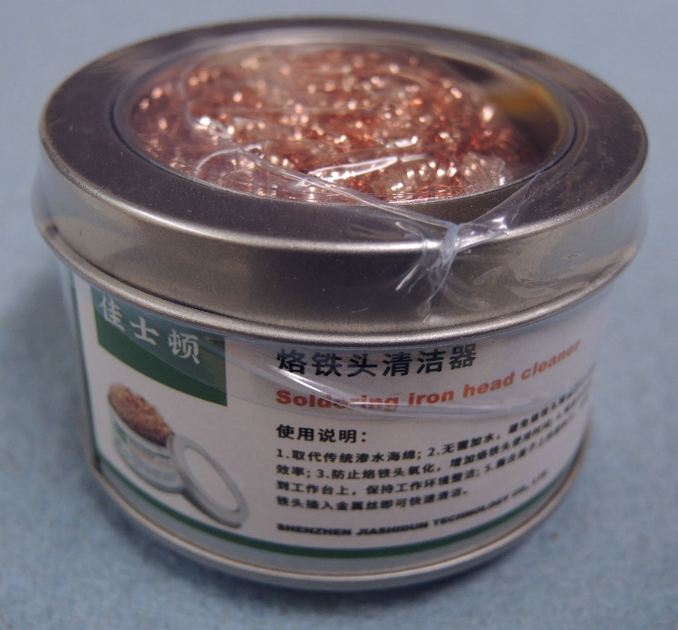
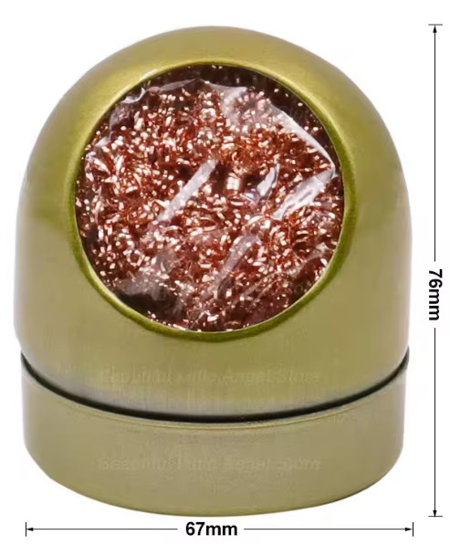
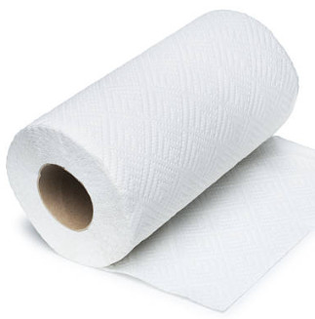
Soldering Iron Holders & Tip Cleaners (Cont’d)
AliExpress $4
Paper Towel
AliExpress $7

Slide 23
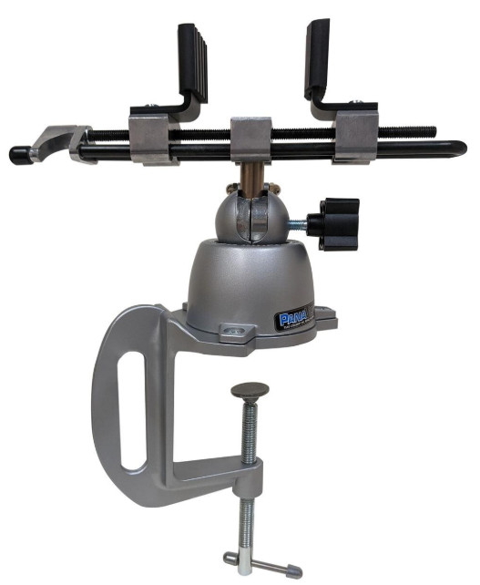
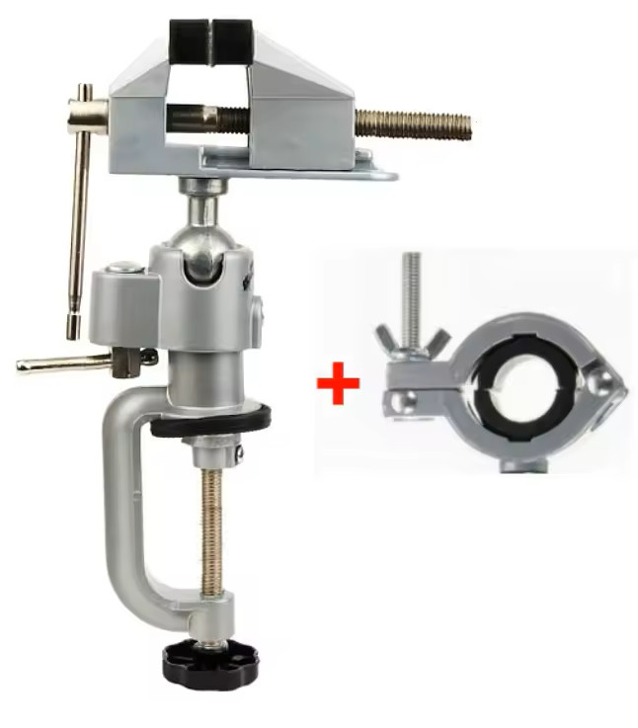
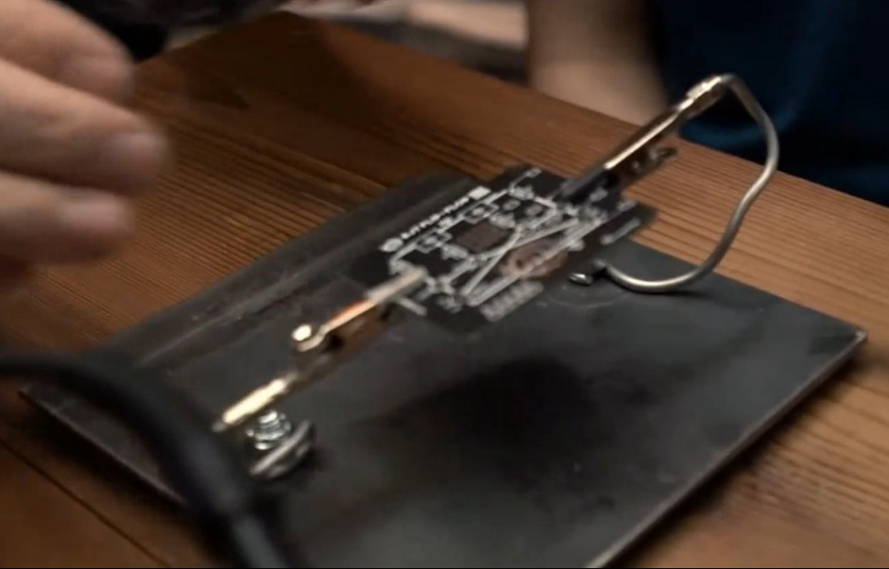
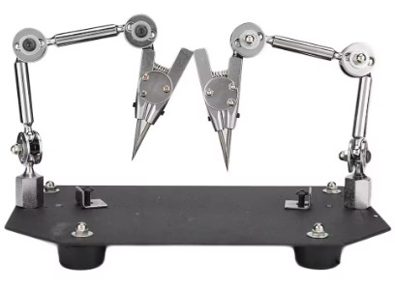
A third hand - Vices & Helping Hands
Attributes to look for general assembly
  Easily movable
  Holds work firmly & securely where you want it
  Easily make a wide variety of adjustments
  Swivel vice
  Helping hands
Panavise 314HD Mouser $218
HelpingHands homemade
AliExpress $33
Welding work clips AliExpress $74

Slide 24
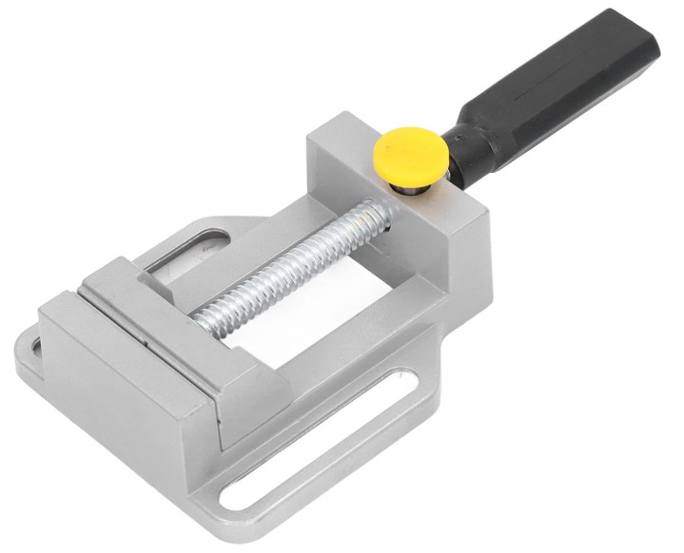
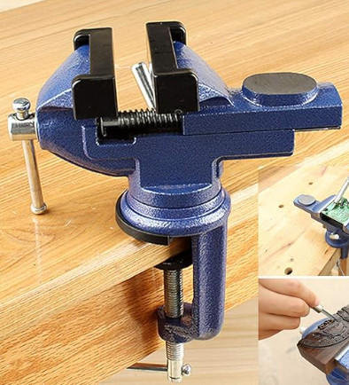
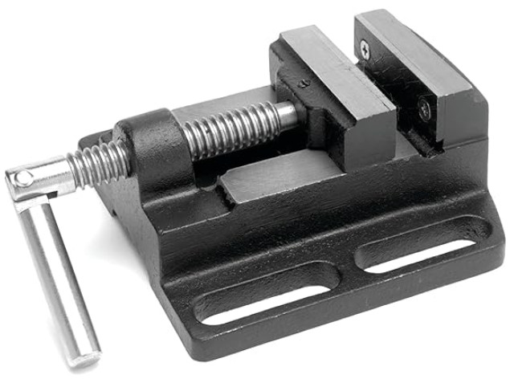
A third hand - Vises & Helping Hands
And for bigger items…
Drill Press Vise Amazon $20
Mytec bench vise Amazon $38
Machinist Vise Amazon $23
AliExpress $33

Slide 25
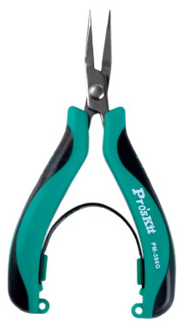
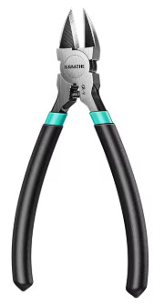
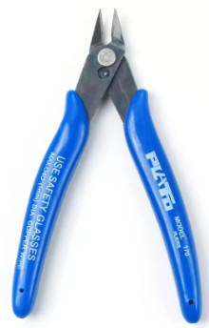
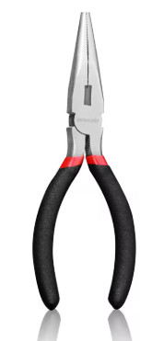
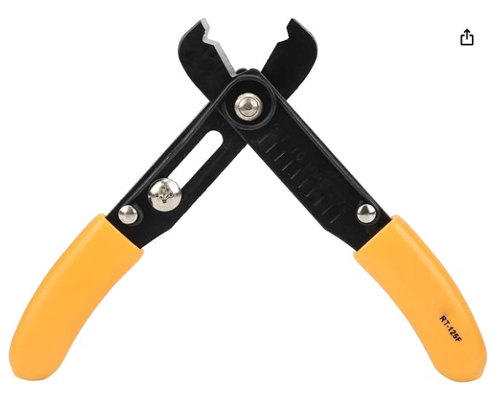
Hand Tools
PM396G Pro’s Kit AliExpress $13
Side Cutters / Diagonal Pliers…in two sizes
  Small, sharp, able to clip small wires
  Plato model 170 AliExpress
  6-8 inch for larger items
Needle nose pliers …in two sizes
  Small ones with smooth jaws
    Great for lead bending
    Gets parts into tight spaces
    Pro’s Kit PM-396G AliExpress $14
  6 -7 inch large ones for bigger stuff
Wire Strippers
  Set screw adjusts cut dia
Gloves
Plato 170
AliExpress $4
6-8in diags AliExpress <$10
6-7in Needle Nose Pliers AliExpress <$10
YWBL-WH Amazon $13
Notes:
For large wires and other antenna stuff the larger side cutters and needle nose pliers will do. But if you venture into PCB work two sizes will serve you better

Slide 26

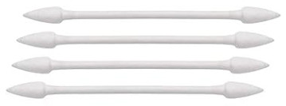

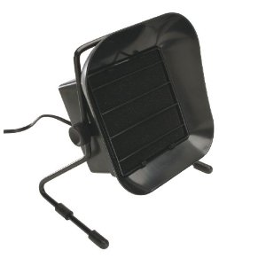
Hand Tools & Supplies
Exacto knife AliExpress $6 for 2 + blades
Additional useful items…
  Exacto style knife AliExpress $6
Flux removal & clean-up
  Isopropanol alcohol 99%
    Used for cleaning flux
  Pointed tip cotton swabs Amazon 800 for $14
    Less likely to leave cotton strands on work
  An old toothbrush
  Absorbent cloth
Bench to Smoke Absorber
  Don’t inhale fumes from solder
  Check filter replacement availability before purchasing
Isopropyl Alcohol $5-7
Flexzion Smoke Absorber
Amazon $62
Other fume extractors $40-$350

Slide 27
Next Session
Materials that will be provided through your course fees
  Small side cutters
  Exacto knife and blades
  Solder flux
  14 & 18 gage wire
  Heat shrink - three diameters
  Solder
  Two PL259m connectors with reducers
  2m length of RG8x
You need to bring… (or borrow)
  Soldering equipment
  Large side cutters
  Vise
  Wire strippers
  Ruler
  Heat gun

