Slide 1
About Soldering Stuff
Antenna Focus…Session 2
VE3CZO

Slide 2

In Todays Session we will…
Tin a wire
  With 18 gage and 14 gage wires
Join 2 wires together and weather proof the joint
  Use wires of two different gauges and two joint types
Join 3 wires together and weather proof the T section
  Use two different gauges
Notes:
Why 18 and 14 ga wire? 18 ga as it’s about the smallest ga that will withstand outdoor use, and 14 ga because it becomes very costly to use any larger gauges.

Slide 3
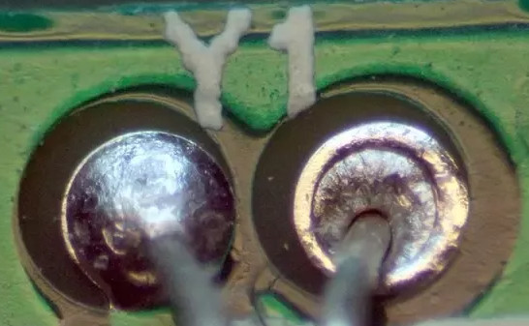
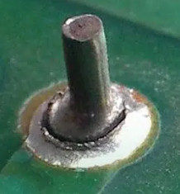
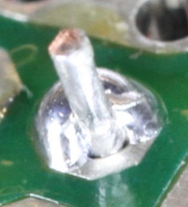
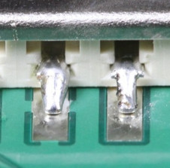
Telling a good solder joint from a bad one
Cold solder joints
  Caused by insufficient heat being applied before the soldering iron is removed
    The solder joint appears dull or crusty and does not have a smooth fillet
    The solder joint has lines cracks or other demarcations
Insufficient Wetting
  Solder fails to flow completely covering the solder pad
Notes:
It’s fairly easy to tell a good solder joint from a bad one with visual inspection.

Slide 4
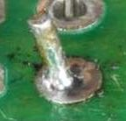
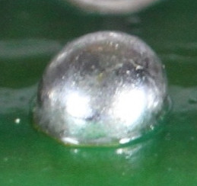
Telling a good solder joint from a bad one
Insufficient solder
  Ok electrically but difficult to visually inspect
Too much solder
  Maybe ok but impossible to tell by inspection as the solder completely covers the joint
Notes:
It’s fairly easy to tell a good solder joint from a bad one with visual inspection.

Slide 5
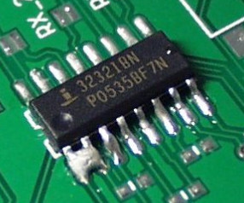
Telling a good solder joint from a bad one
Disturbed Solder Joint
  A movement occurs at the solder joint while the solder is solidifying
  The surface of the solder joint looks frosted, crystalline or rough
Solder Bridge
  Excess solder creates a short between two or more solder lands
Notes:
It’s fairly easy to tell a good solder joint from a bad one with visual inspection.

Slide 6
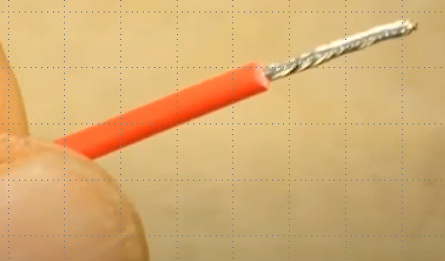
Tin a Wire
Original video was eliminated to save file size. It is available on You Tube here..
  URL… https://www.youtube.com/watch?v=pRPF4wpXX9Q
  You Tube contributor that created this video…learnelectronics
  Video title… How to tin a wire
  Play section 1:33 to 2:25

Slide 7
Tinning…
Tin both ends of a 10cm length of wire
  Start with the 14 gage wire
    Trim 1 cm of insulation from both ends with either the Exacto knife or wire strippers
      Don’t cut any wire strands and if you do…cut the end off and begin again
      Twist the wire tightly
    When soldering remembering to…
      ALWAYS start by cleaning the soldering iron tip
      Apply a small amount of solder to the tip
      Place the tip under the wire and align the tip for maximum contact with the wire for best heat transfer
      Allow the wire to heat for a few seconds the begin probing the area near the soldering iron tip with the solder looking for it to melt. Apply solder along the top of the wire with the soldering iron on the bottom
      Apply sufficient solder to the wire to thoroughly coat it with solder
    Check the soldering result
      Turn the wire around making sure the solder has penetrated to all areas
      Check the amount of solder wicking … a little is ok, a lot and you’ve used too much solder
  Repeat with the 18 gage wire.

Slide 8
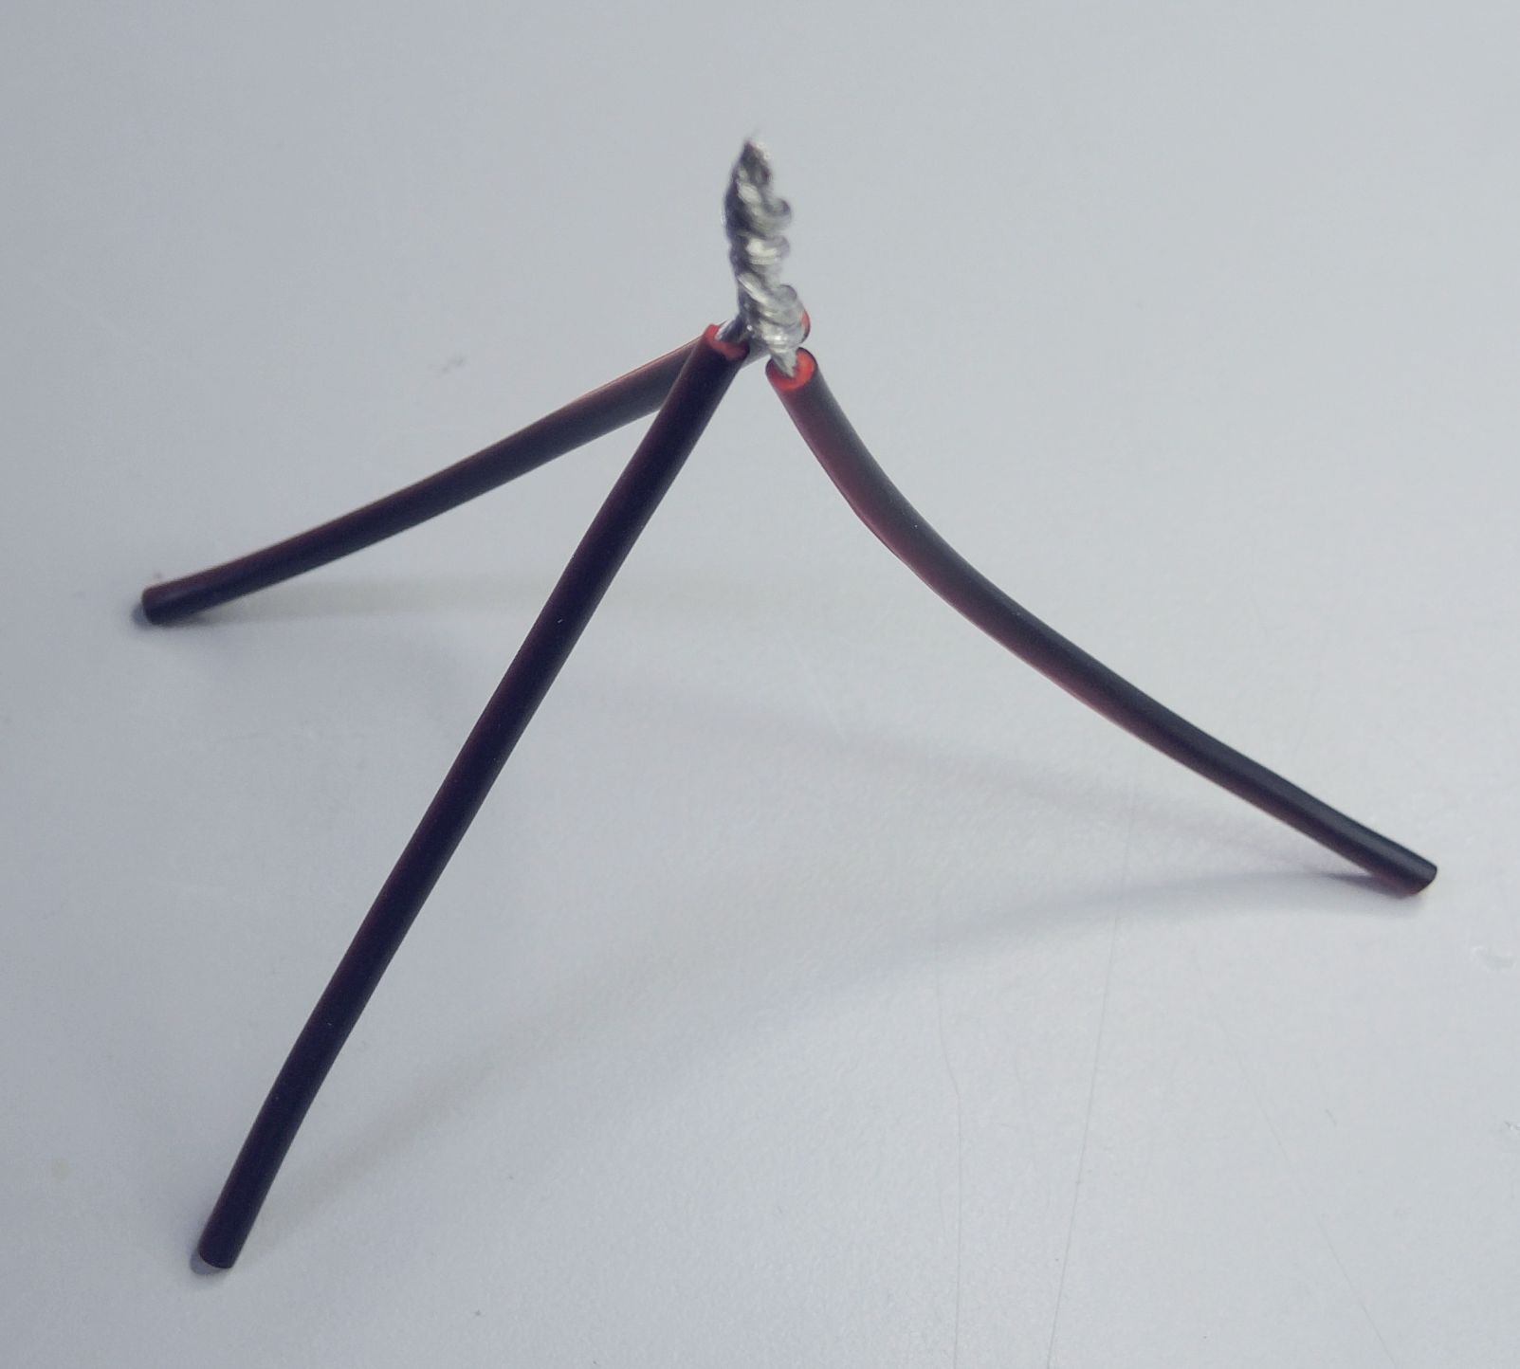
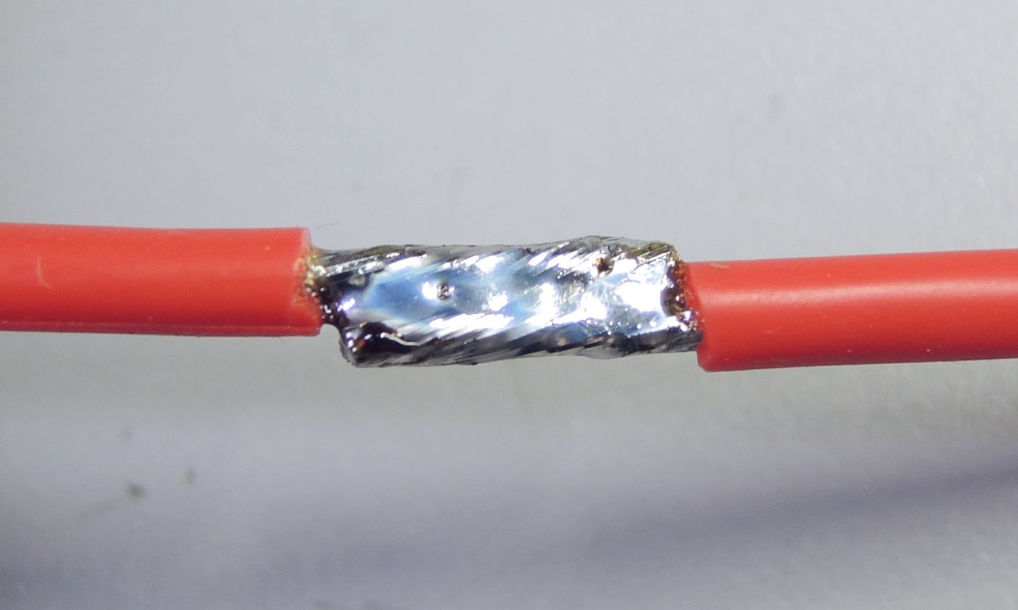
Joining wires together…
Many ways to join wires together
  Pigtail
    Common application – home wiring
  Temporary
    Tin and solder wires together
    Very easy to unsolder
  For outdoor antenna use there are better ways…
Notes:
YouTube has many videos on joining wires together…some very good…others not so.

Slide 9
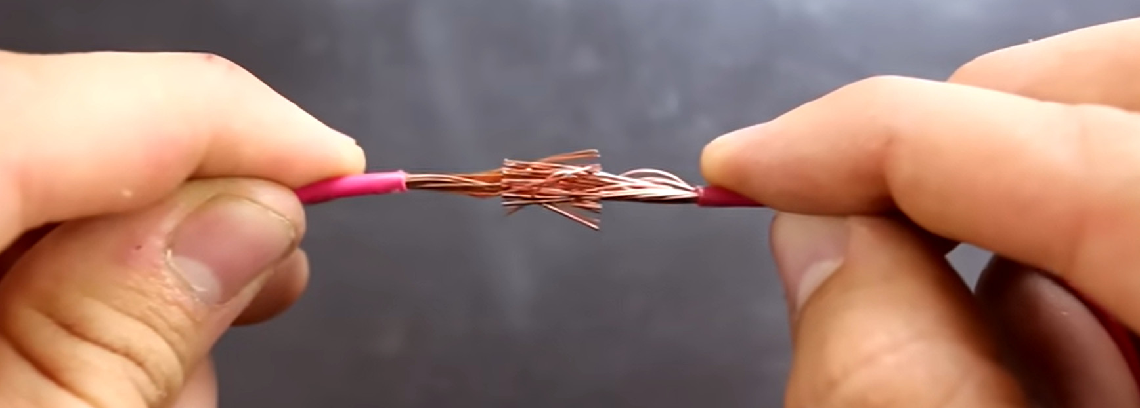
Joining two wires using mesh technique
Original video was eliminated to save file size. It is available on You Tube here..
  URL… https://www.youtube.com/watch?v=Zu3TYBs65FM
  You Tube contributor that created this video…ChrisFix
  Video title…How to Solder Wires Together (Best Tips and tricks)
  Play section 7.43 to 8:01

Slide 10
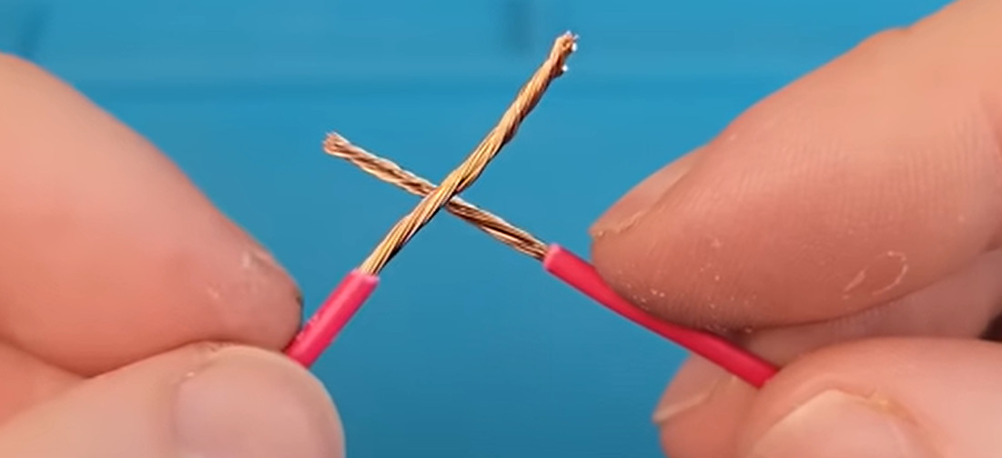
Joining 2 wires by twisting + soldering
Original video was eliminated to save file size. It is available on You Tube here..
  URL… https://www.youtube.com/watch?v=4xUBRMgcVhc
  You Tube contributor that created this video…Will Donaldson
  Video title… Four Steps to Flawless Wire Joints (How to Solder)
  Play section 5:13 to 11:44

Slide 11
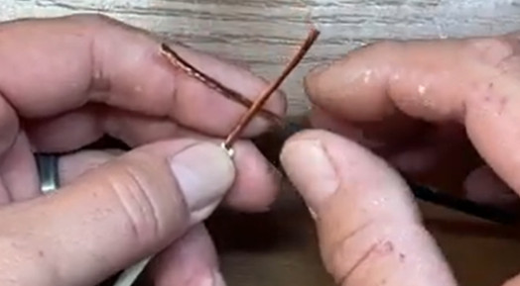
Joining two wires… Western Union Joint
Original video was eliminated to save file size. It is available on You Tube here..
  URL… https://www.youtube.com/watch?v=SKr3h1cHIiM
  You Tube contributor that created this video… Tx Tool Crib
  Video title… Splicing Electrical Wire : Western Union Splice (Lineman’s Splice)
  Play section 2:03 to 3:07

Slide 12
Joining two wires…
Start with two 10cm long pieces of wire
  Begin with the 18 gage wire (because it’s easier)
    Using the mesh technique…
      Trim 1 cm of insulation from one end of both pieces of wire
      Don’t cut any wire strands and if you do…cut the end off and begin again
      Separate the wire strands on both pieces, mesh them together and twist.
    Using the twisting or Western Union technique…
      Trim off 2-2.5 cm of insulation from both pieces of wire for twist and a little more 2.5-3mm for the western union
      Take care to remove the same length of insulation from both wires
      Don’t cut any wire strands and if you do…cut the end off and begin again
      Twist the wires together following the video instructions and check the joint quality
    When soldering remembering to…
      ALWAYS start by cleaning the soldering iron tip
      Apply a small amount of solder to the tip
      Place the tip under the wire and align the tip for maximum contact with the wire for best heat transfer
      Allow the wire to heat for a few seconds the begin probing the area near the soldering iron tip with the solder looking for it to melt. Apply solder along the top of the wire with the soldering iron on the bottom
      Apply sufficient solder to the wire to thoroughly coat it with solder
    Check the soldering result
      Turn the wire around making sure the solder has penetrated to all areas
      Check the amount of solder wicking … a little is ok, a lot and you’ve used too much solder
  Repeat with the 14 gage wire.

Slide 13
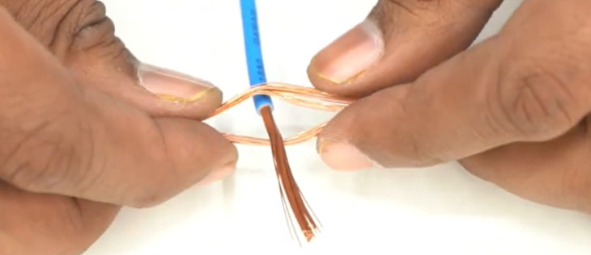
Joining 3 wires…Tap Splice
Original video was eliminated to save file size. It is available on You Tube here..
  URL… https://www.youtube.com/watch?v=MoJKZ_JqHfU
  You Tube contributor that created this video… Mr. AX : The BackBencher Experiment
  Video title… BRILLIANT idea! Proper wire 3 way| Perfect Twist Electric Wire Together
  Play section 1:00 to 2:40

Slide 14
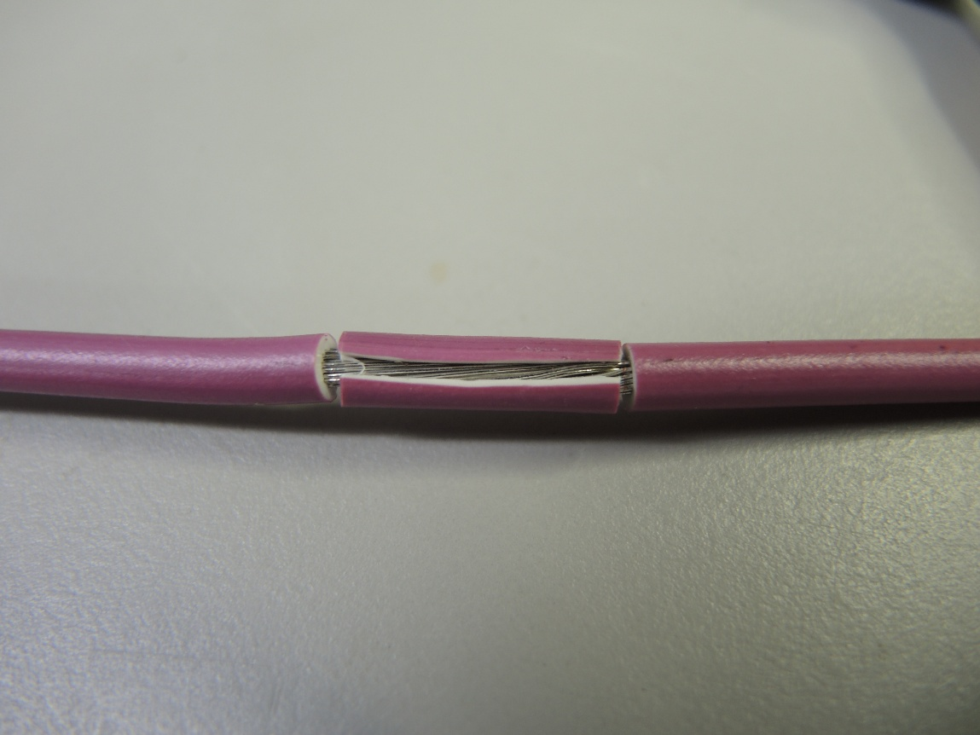
Joining Three Wires… Tap Splice
Start with two 10 cm long pieces of 14 gage wire
  Strip 1.5cm of insulation from the center of one of the pieces of wire
    Using the Exacto knife make two scores on one piece of wire each ¾ of a cm from the center for a total 1.5cm width and remove the insulation by cutting the 1.5cm length between the scores with the knife. Remove this section of insulation

Slide 15
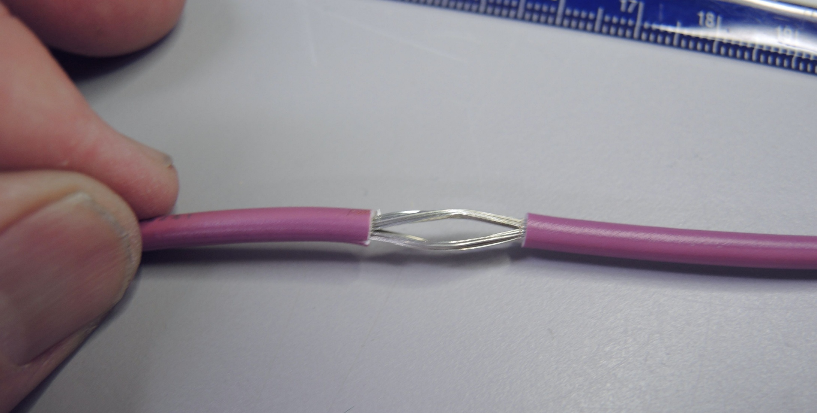
Joining Three Wires…
Start with two 10 cm long pieces of 14 gage wire
  Untwist the wire and using the knife separate the strands into two halves.

Slide 16
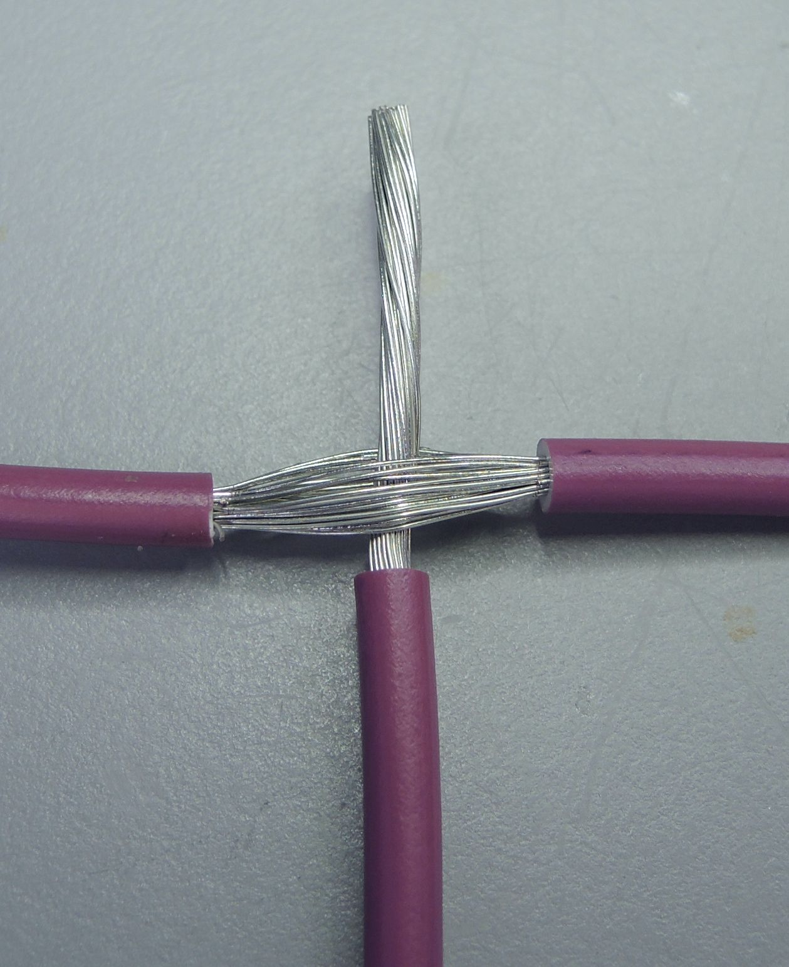
Joining Three Wires…
Start with two 10 cm long pieces of 14 gage wire
  Remove 2cm of insulation from the second piece of wire and twist the wire tightly
  Insert the second piece of wire through the center of the first piece and twist the first piece so that the second piece is held firmly in the center of the splice.

Slide 17
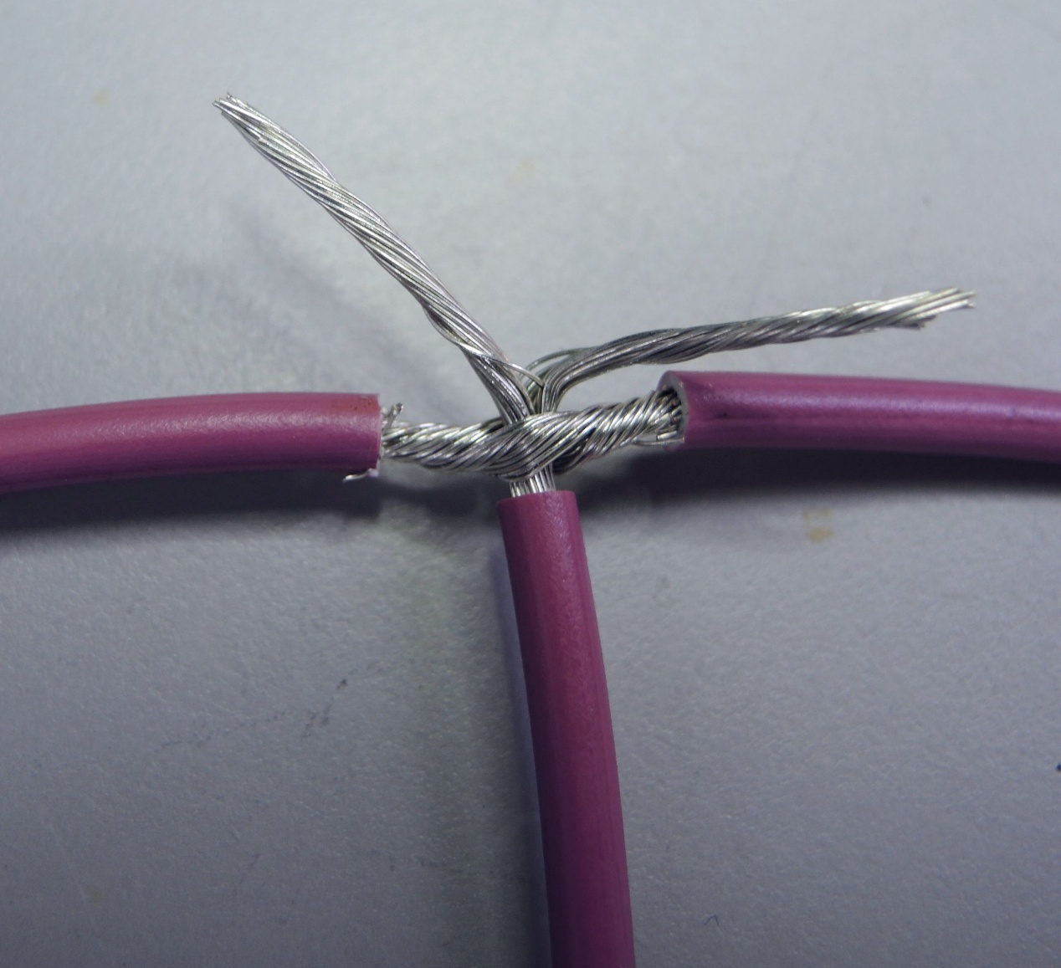
Joining Three Wires…
Start with two 10 cm long pieces of 14 gage wire
  Untwist the second wire’s strands and split them into two equal parts then twist each part back together

Slide 18
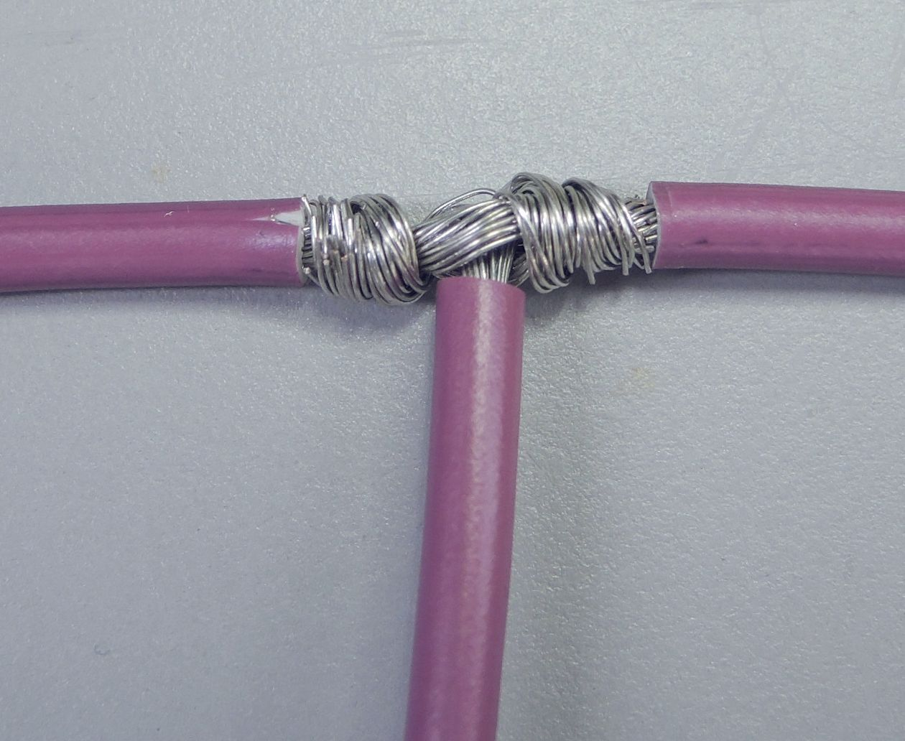
Joining Three Wires…
Start with two 10 cm long pieces of 14 gage wire
  Take the two parts of the second wire and twist one part clockwise and the other part counterclockwise around the first piece.

Slide 19
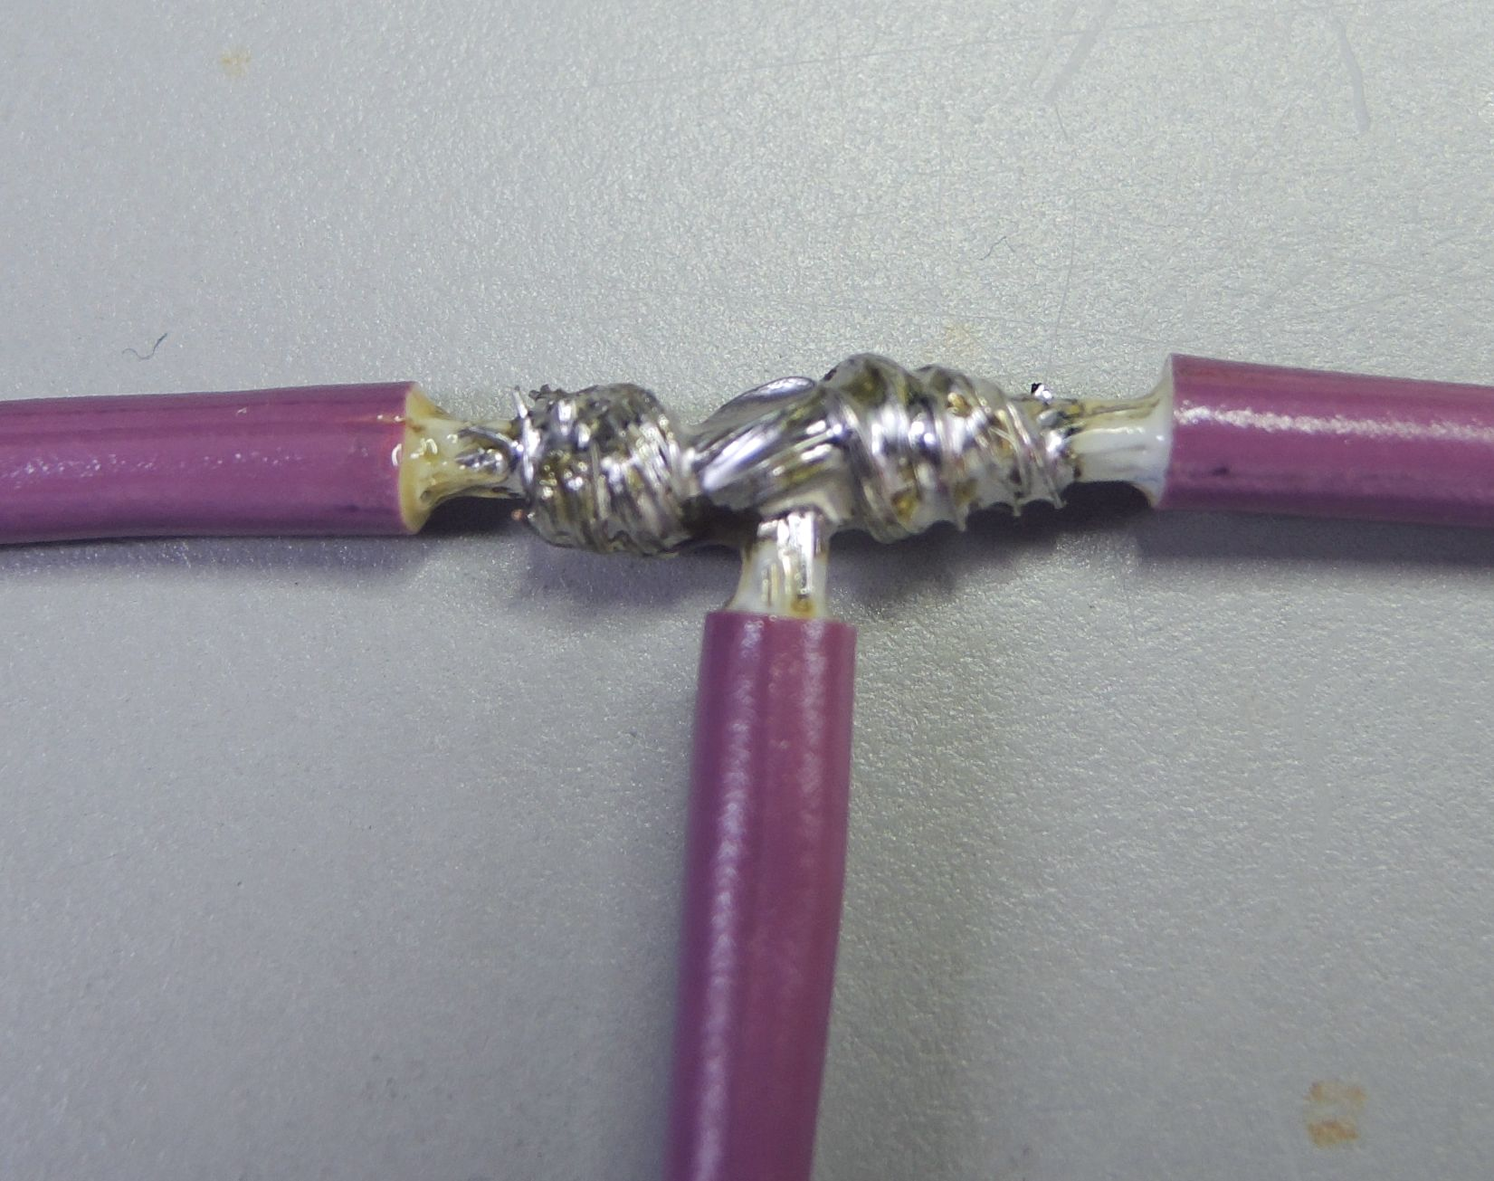
Joining Three Wires…
Start with two 10 cm long pieces of 14 gage wire
  Solder the assembly
Repeat with the 14 gage wire.

Slide 20
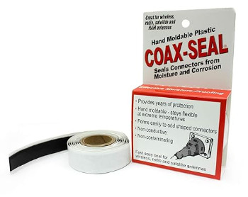
Weatherproofing Joints…
Coax Seal
  It works
  It’s extremely difficult to remove
  Can harden and crack over time
  Good for awkward joints that can’t
  easily be encircled

Slide 21
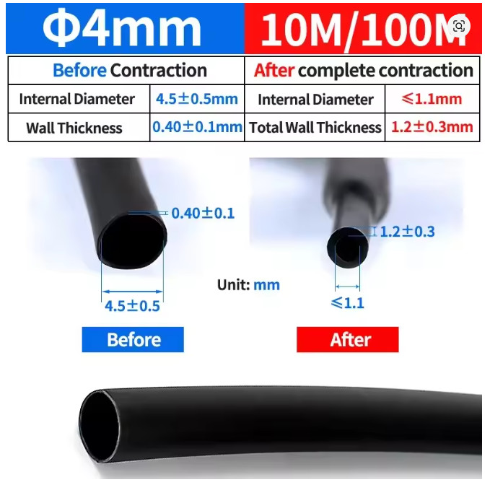
Weatherproofing Joints…
Adhesive lined heat shrink
  Adhesive lining provides very good weatherproofing
  Available in various diameters 0.6mm to 100mm
  Available in various shrink ratios
    2:1 3:1 4:1 … generally cost increases the higher the shrink ratio
  Wall thickness increases after shrinking
  UV resistant

Slide 22
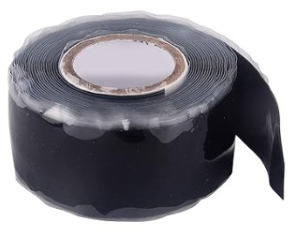
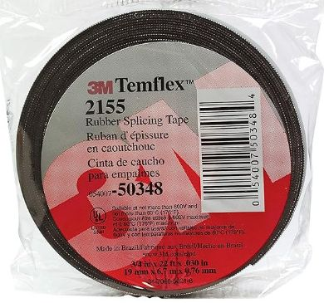
Weatherproofing Joints…
Self Fusing Silicone Tape
  Available in a variety of thicknesses (
    I prefer thinner tape 1mm or so thick as it’s much easier to apply
  Rolls are typically 25mm wide
    May be a bit wide for small projects like used on wire splices but can be sliced thinner (12mm better!)
  Very good waterproofing
  Is NOT UV resistant
    So should be protected with a layer of vinyl electrical tape

Slide 23
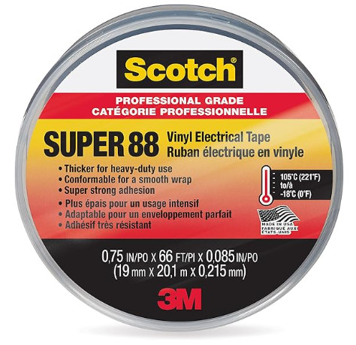
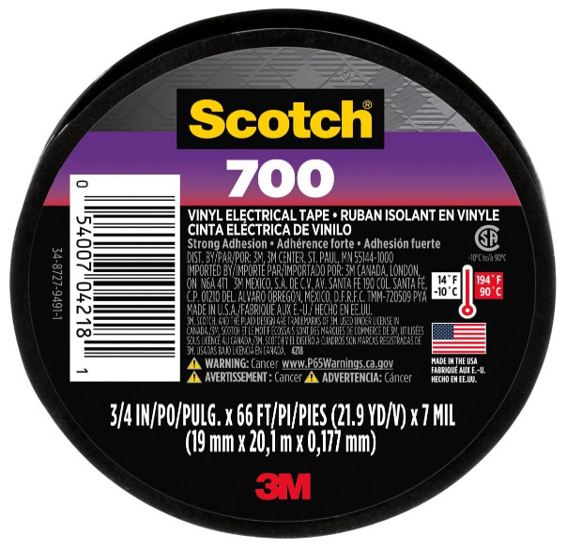
Weatherproofing Joints…
Vinyl Electrical Tape
  Look for useful application temperate range
    Tape remains flexible enabling good sealing
  Scotch Super 88 costs a bit more but has
  a wide application temperature range
    -18 to 105C
  Scotch 700 lower cost
    10 to 90C temperature range

Slide 24
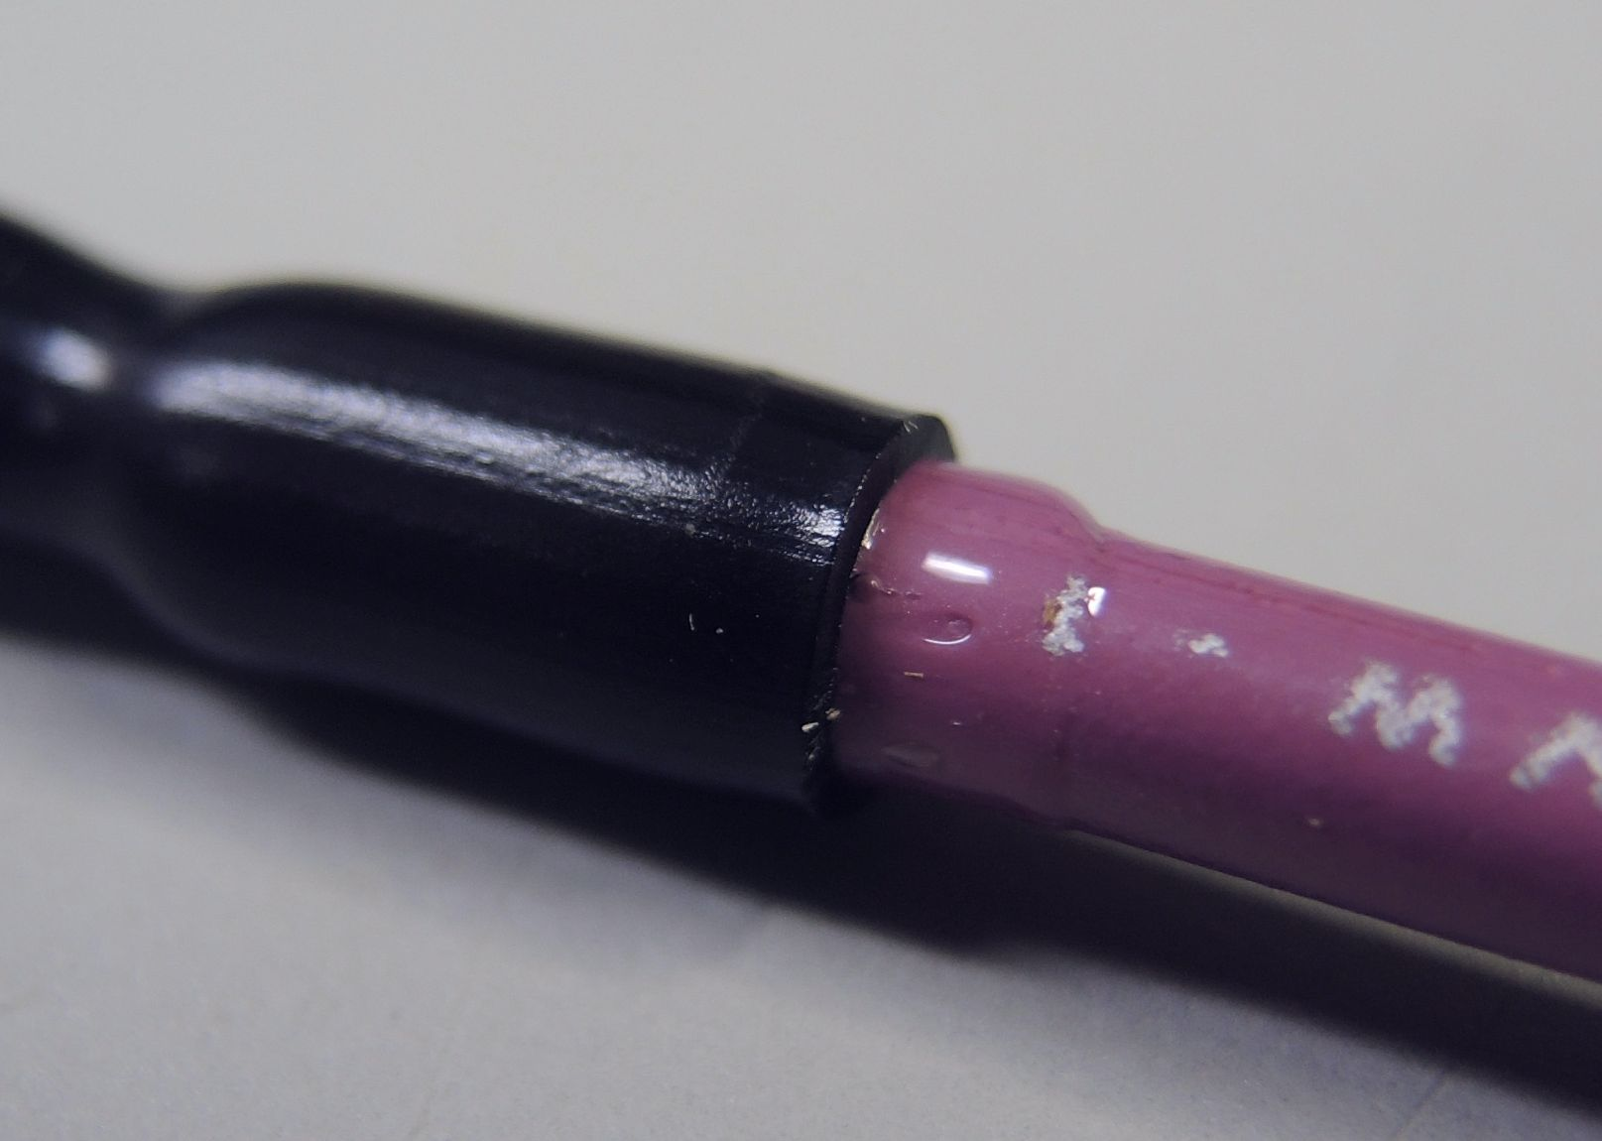
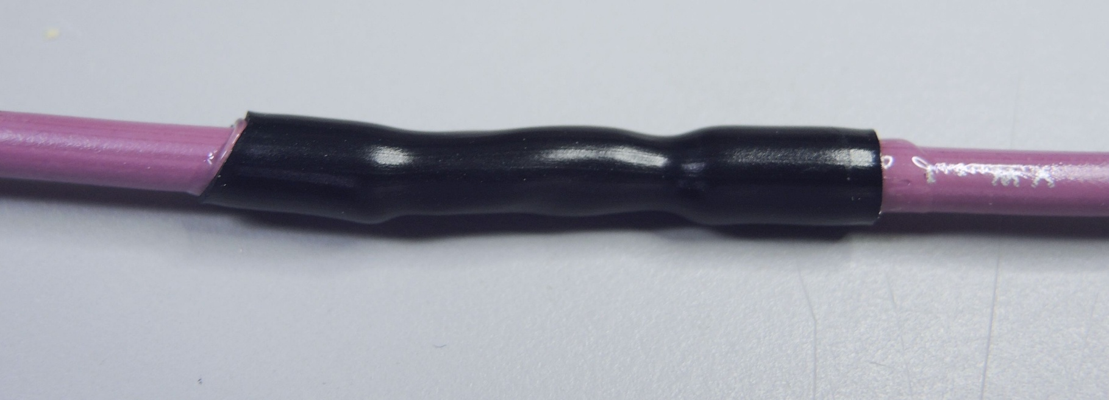
Weatherproofing Joints…
Weather proof the two wire joints
  Select the correct diameter of heat shrink
  Cut a length of shrink so that it overlaps each end of the joint by about 1cm
  Keep the shrink in place and Apply heat (generously)

Slide 25
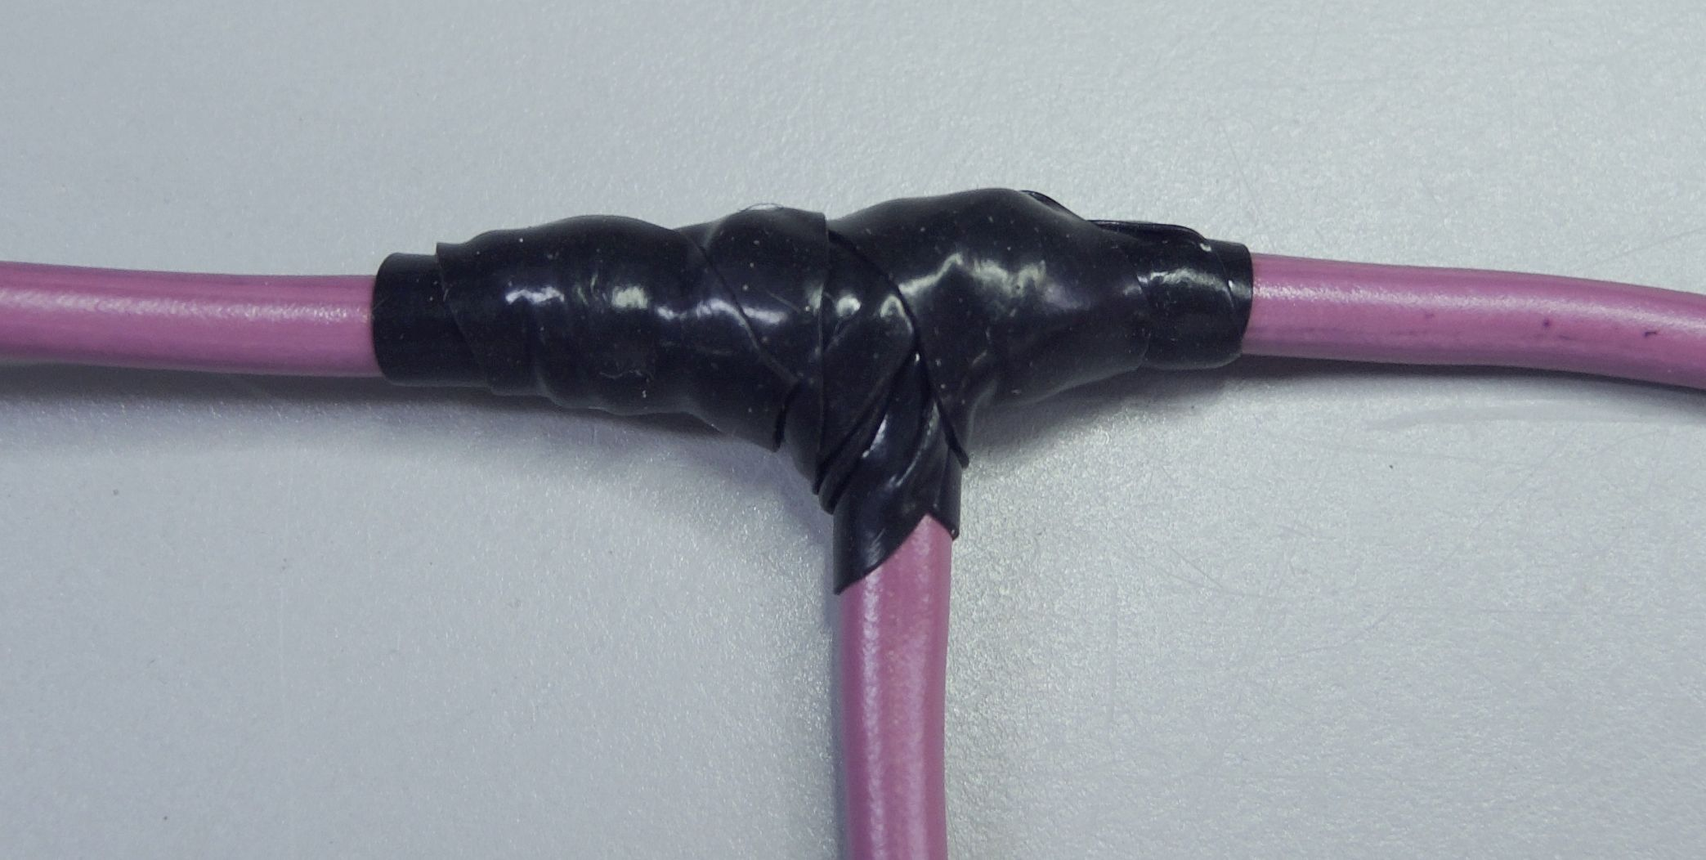
Weatherproofing Joints…
Weather proof the three wire joint
  Cut a 15cm length of self sealing silicone tape and if it’s 25mm wide slice it in half to make two 12.5 mm pieces.
  Wrap the tape around the joint by stretching it moderately and overlapping each turn by about half the width of the tape.

Slide 26
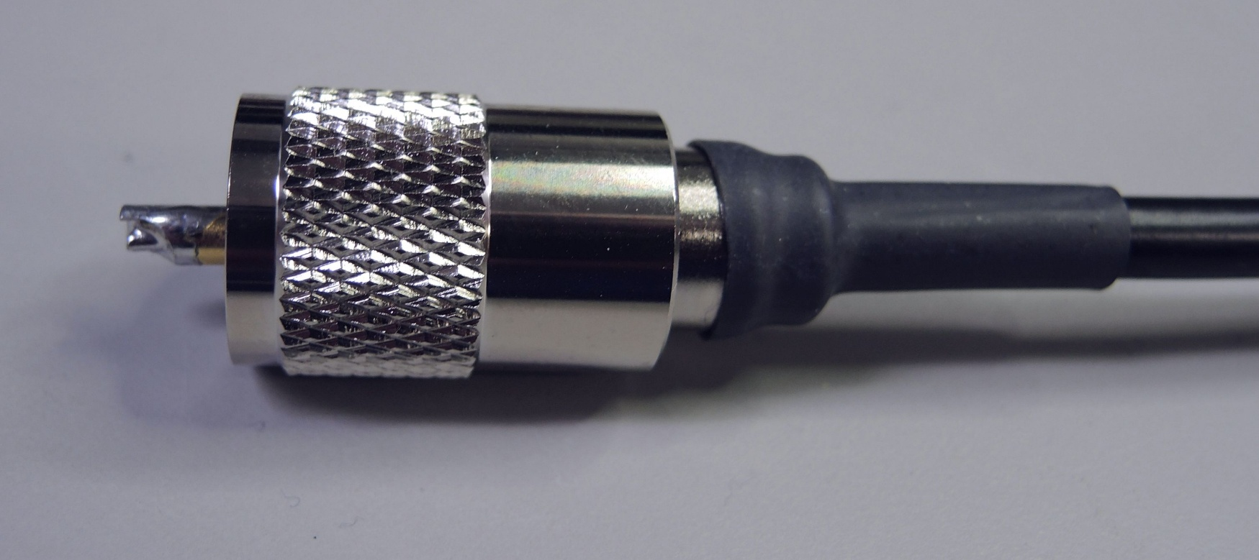
Next Session…
A bit about coax cable and connector characteristics
  Cable & connector quality…what to look for and some things to avoid
  Cable & connector loss versus frequency
  Connector VSWR
Soldering Connectors onto Coax
  Create a RG8X two meter jumper cable with 2 PL259’s

